Slide 1


“2 PLAYER CHESS”
Presenter Name:-
Aman Kumar(12020002017042),
Pankaj kumar(12020002017006),
Umesh Raj(12020002017027),
Mohit kumar(12020002017021)

Slide 2
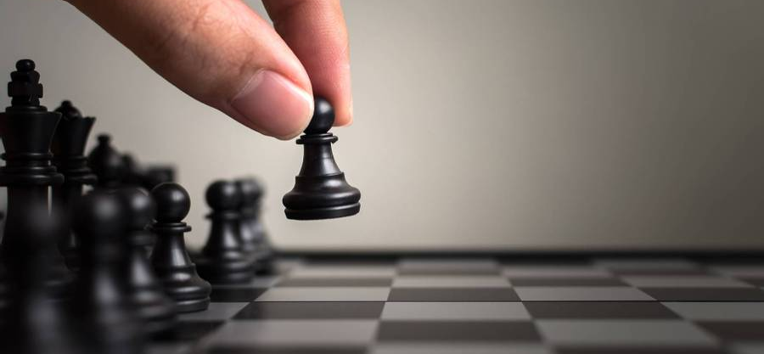

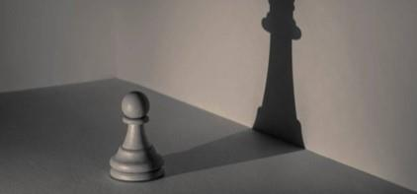
Goals of our project:-
First goal is to allow two users or players to play the game interactively
The second goal will be that the program should be working and allow the users to play the game
IMPROVES PROBLEM SOLVING TECHNIQUES
IMPROVE LOGIC AND REASONING SKILLS
INCREASE PATIENCE AND PERSISTENCE
IMPROVES DECISION-MAKING SKILLS

Slide 3
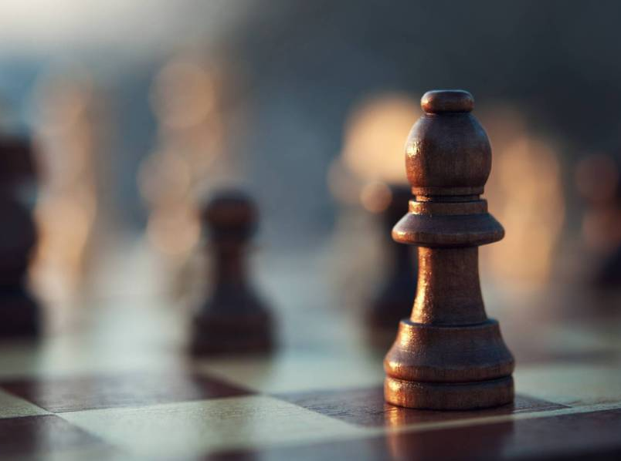
Introduction
The project ‘DESIGNING OF 2 PLAYER CHESS GAME USING COMPUTER GRAPHICS’ implements a classic version of Chess with a Graphical User Interface (GUI). The Chess game follows the basic rules of chess, and all the chess pieces only move according to valid moves for that piece. Our implementation of Chess is for two players (use of Artificial Intelligence). It is played on an 8x8 checked board. We successfully created a GUI using text-based version, inheritance and templates, as specified. Despite several unusual bugs in the GUI, our Chess program is a great, userfriendly game for two players..

Slide 4


Requirement Specification:-
Software Requirement Specification:-
Language: Python 3 with graphics
Platform: Windows operating system.
Hardware Requirement Specification:
RAM: 128MB (Minimum).
Processor: core i3 and above.
Hard Disk: 150 MB.
Includes Memory Storage, a mouse, a keyboard.

Slide 5
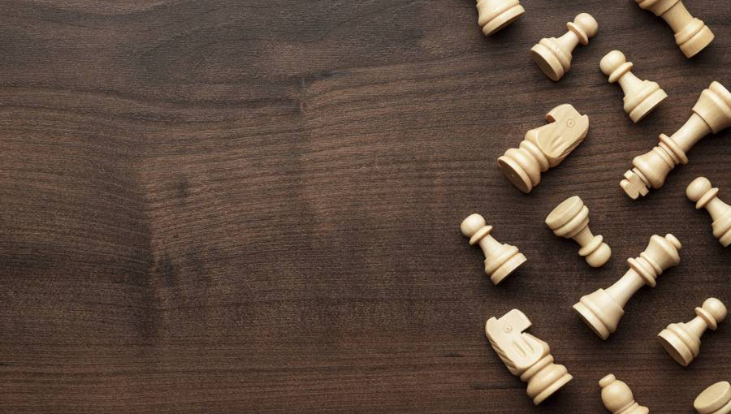
Abstract Representation of a Game:- An abstract representation of a game is a set of rules which allow a player to play the game lawfully, but which is more compacted than the general representation of the game. The concept of abstract representation is basic to all work on games in AI. It is a prerequisite for game analysis. Thus game analysis is significantly dependent on the existence of an abstract representation of the game. CHESS includes an interface resembling a common chessboard. CHESS require python3 installed, memory space and storage space on the user computer to save data. Furthermore, the computer will need memory space because CHESS is only accessible to computers what had installed the application. However, CHESS is not portable and the clients will need to install one time the chess application on each computer that will be used to play.

Slide 6
Movement:-
Pawn: One of eight men of one color and of the lowest value usually moved one square at a time vertically and capturing diagonally.
King: The main piece of the game, checkmating this piece is the object of the game. It can move 1 space in any direction.
Knight: This piece can move 1 space vertically and 2 spaces horizontally or 2 spaces vertically and 1 space horizontally. This piece looks like a horse. This piece can also jump over other pieces.
Queen: This piece can move in any number of spaces in any direction as long as no other piece is in its way.
Rook: one of two pieces of the same color that may be moved any number squares horizontally or vertically, as long as no other piece blocks its way.

Slide 7
Bishop: one of two pieces of the same color that may be moved any number squares diagonally, as long as no other piece blocks its way. One piece always remains on White squares and the other always on Black. The bishop has no restrictions in distance for each move, but is limited to diagonal movement. Bishops, like all other pieces except the knight, cannot jump over other pieces. A bishop captures by occupying the square on which an enemy piece sits.
The bishops may be differentiated according to which wing they begin on, i.e. the king's bishop and queen's bishop. As a consequence of its diagonal movement, each bishop always remains on either the white or black squares, and so it is also common to refer to them as light-squared or dark-squared bishops...
Checkmate: a situation in which an opponent’s king is in check and it cannot avoid being captured. This then brings the game to a victorious result.

Slide 8
Other movements:-
EN PASSANT: When a pawn advances two squares from its starting position and there is an opponent's pawn on an adjacent file next to its destination square, then the opponent's pawn can capture it en passant (in passing), and move to the square the pawn passed over. This can only be done on the very next move, otherwise the right to do so is forfeit.
CHECK: When a king is under immediate attack by one or two of the opponent's pieces, it is said to be in check. A response to a check is a legal move if it results in a position where the king is no longer under direct attack (that is, not in check). This can involve capturing the checking piece;interposing a piece between the checking piece and the king (which is possible only if the attacking piece is a queen, rook, or bishop and there is a square between it and the king); or moving the king to a square where it is not under attack. Castling is not a permissible response to a check. The object of the game is to checkmate the opponent; this occurs when the opponents king is in check, and there is no legal way to remove it from attack. It is illegal for a player to make a move that would put or leave the player's own king in check.

Slide 9
CASTLING:-Once in every game, each king is allowed to make a special move, known as castling Castling consists of moving the king two squares along the first rank toward a rook (which is on the player's first rank) and then placing the rook on the last square that the king has just crossed.
Castling is permissible under the following conditions:
1.Neither the king nor the rook have previously moved during the game.
2.There cannot be any pieces between the king and the rook.
3.The king cannot be in check, nor can the king pass through squares that are under attack by enemy pieces, or move to a square where it would result in a check.

Slide 10
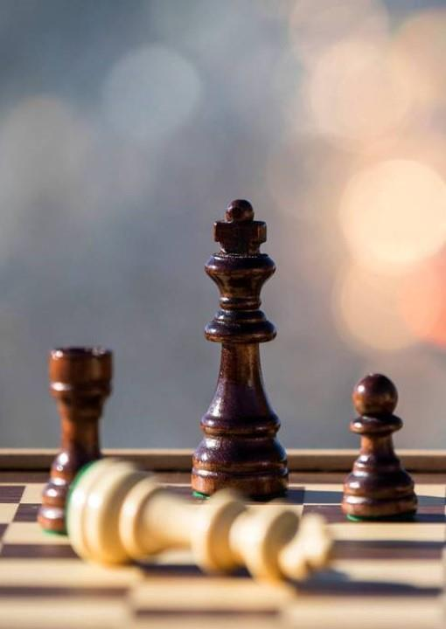
Approach used:-
We have used python language for this 2 player chess game.
We used tkinter module to write this program since it can easily give us the interface.
First we create the window object which is the window that comes up when we run the chess game on. We set the dimensions to 800x800 which is the tuple argument which we passed into it. We specifically chose 800 x 800 because the images for the chess pieces that we hard were all 100x100 which meant it would fit perfectly if the board was 800x800.
The main thing that makes my program work are these node objects and they are just the containers which hold the chess pieces(they are simulated as the tiles of the chess board in this case. They have their attributes which are their row, column,x,y co-ordinates. We need these separately because all these nodes are going to be stored in a 8x8 2d list so if we call it we would need to call it using its row and col numbers while if we were drawing it onto the screen we need its x,y pixel values.

Slide 11
The draw function is used to used to draw the tile onto the screen(so the black and white pattern) while the setup method is used to draw any images onto the screen if we had a piece on the screen at that position. You draw onto the screen using blit.
Draw grid draws the boundaries to the grid(so the black horizontal and vertical lines that separate the tiles) and draw grid and make grid is creating the 2d list which are going to use to access all the nodes later. Update display is used to update the screen every-time the tick. I think to avoid the CPU being overloaded, we chose to run the program at 20fps which is ofc completely unreasonable for chess but we didn’t want too much delay.
When the user clicks on the screen, we need to figure out what tile they have clicked on which is what find_node does.

Slide 12
Display_potential_moves is a function made but it just takes a list of potential moves and for those moves, changes the colour of the tile so that it stands out.
Do_move is used to acc make the swap on the screen but swapping the values on my dictionary, when the screen updates, this change will be visible on the screen.
remove_highlight is used because it is hard to remove the highlights for specific tiles so we decided to just to redraw the black colours for all the tiles instead.
C ode Google Drive link:- https://drive.google.com/file/d/1AgxbDdmcqpXyvOlD3azamUmbvh1Md-rF/view?usp=sharing

Slide 13
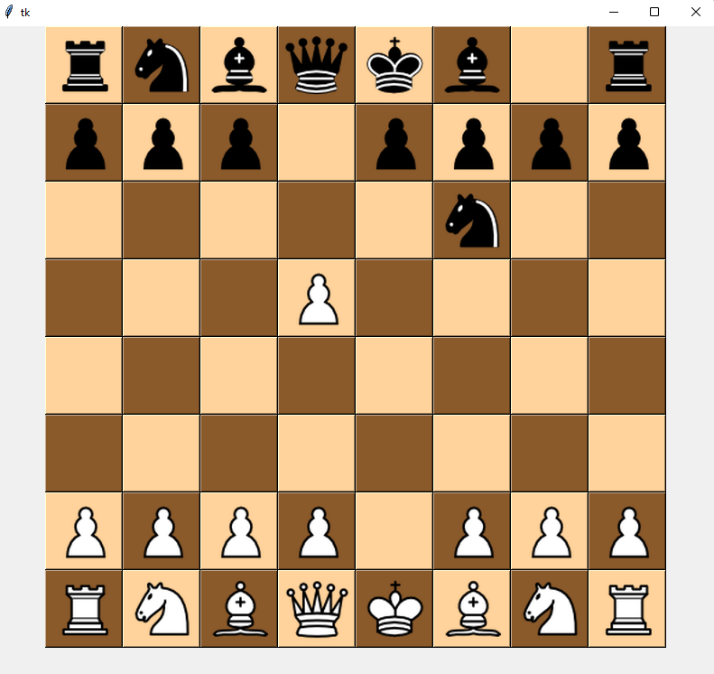
Output:-

Slide 14

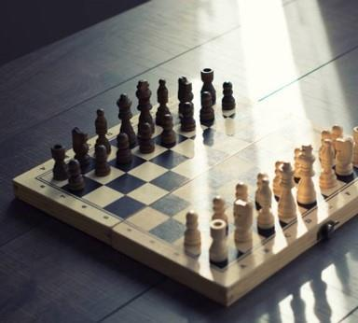
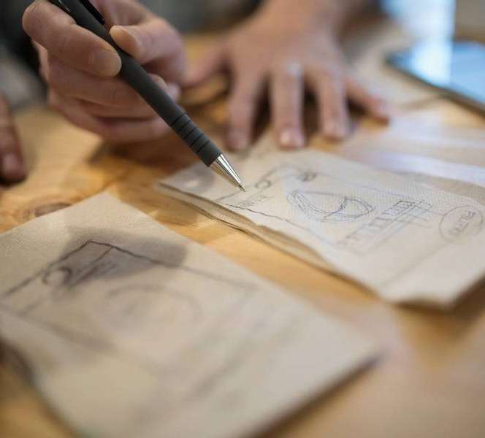
Summary:-
In this project “DESIGNING OF 2 PLAYERCHESS GAME USING COMPUTER GRAPHICS” we presented the classic and standard version of Chess implemented as a GUI. We successfully created a game using inheritance, templates, Artificial Intelligence and a GUI (Graphical User Interface). The project had two aims, all of them which were achieved. The aims of the project were important as they identified what the project was trying to achieve. Their aims were:
• First aim is to allow two users or players to play the game interactively
• The second aim is that the python program for the chess game should be working properly and allow the users to play the game

Slide 15
Thank You

